Slide 1

G. H. RAISONI COLLEGE OF ENGG. & MANAGEMENT Gat No. 1200, Wagholi, Pune – 412 207
(An Autonomous Institute Affiliated to Savitribai Phule Pune University)
Session 2021-22
Presentation on
“cryptocurrency as payment method”
By
Devashri Nandkumar Bhosale (A19)
Pratik Rajesh Jade (A70)
Faculty Name: Dr. Aniruddha S. Rumale
SY B.Tech: Div A

Slide 2
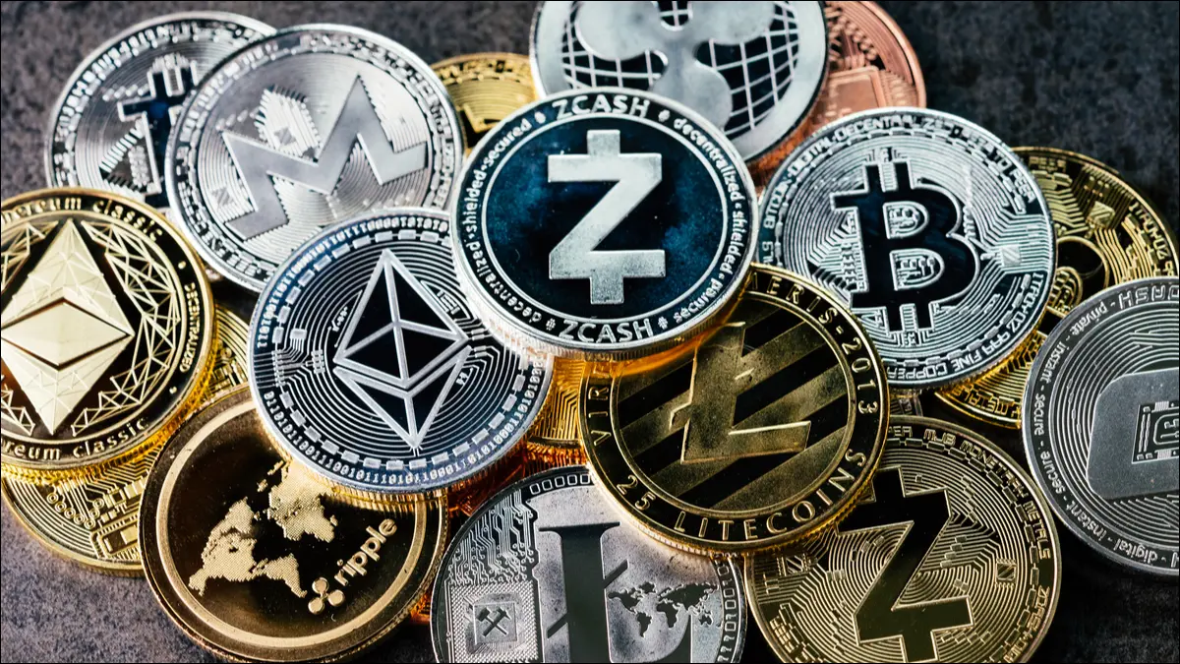
What is Cryptocurrency ?
Cryptocurrency, sometimes called crypto-currency or crypto, is any form of currency that exists digitally or virtually and uses cryptography to secure transactions. Cryptocurrencies don't have a central issuing or regulating authority, instead using a decentralized system to record transactions and issue new units.
Cryptocurrency is a digital payment system that doesn't rely on banks to verify transactions. It’s a peer-to-peer system that can enable anyone anywhere to send and receive payments. Instead of being physical money carried around and exchanged in the real world, cryptocurrency payments exist purely as digital entries to an online database describing specific transactions. When you transfer cryptocurrency funds, the transactions are recorded in a public ledger. Cryptocurrency is stored in digital wallets.

Slide 3
How Does a Cryptocurrency Payment Gateway Work?
Payment gateways are companies taking on the perceived risk of cryptocurrency payments by using their wallet(s) to facilitate transactions between merchants and their customers.
Payment Flow
In terms of steps, the following workflow gets executed:
Your customer opts to make payment in cryptocurrency at checkout (in-store, on the web, or in-app).
They pay you an amount equal to the digital currency's fair market value at the time of the transaction.
The cryptocurrency payment service instantly converts the payment into the currency you choose.
The money is added to your account with the provider; it is deposited to your designated bank account in intervals decided on in your service contract.
The process is transparent to you because you don't have to worry about cryptocurrencies; only that your cryptocurrency service provider will place the appropriate funds in your account.

Slide 4
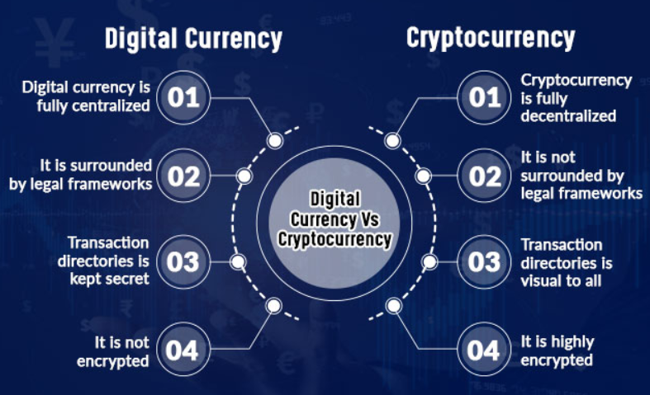
Fees
The provider uses a cryptocurrency wallet to facilitate the transfers. If that currency is designed with a payment system, the provider will incur fees charged by the currency network's transaction validators.
Transaction validators verify blocks and transactions in the blockchain—in exchange for their energy use and computional power, they are paid in small increments in the cryptocurrency transaction they validated.
Cryptocurrency And Digital Currency- Are They Similar?
Aligning cryptocurrency and digital currency on the same platform could be a huge mistake that could happen if you won’t draw the distinction. Cryptocurrency is a subset of digital currency but not its identical twin. From the fastest port of transaction to the development of blockchain technology, cryptocurrencies ensure a high degree of privacy and secure transactions. Nonetheless, many economists didn’t approve cryptocurrency as it fluctuates widely.

Slide 5
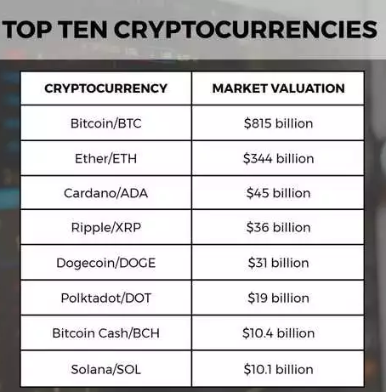


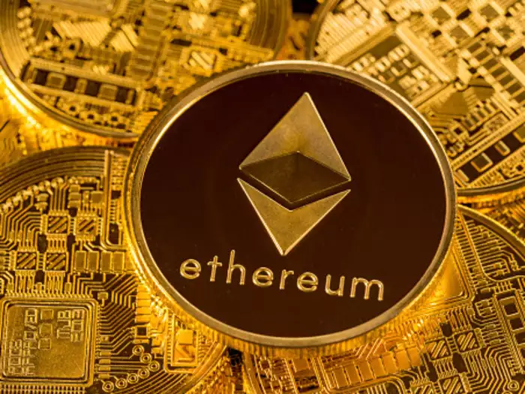
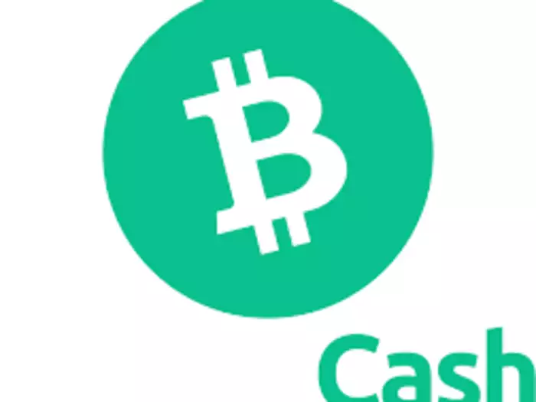
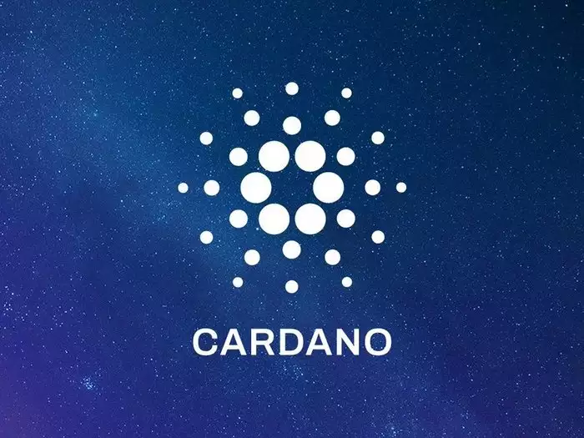

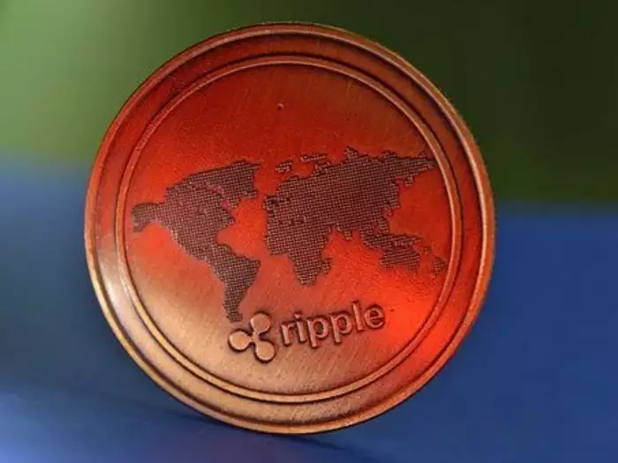
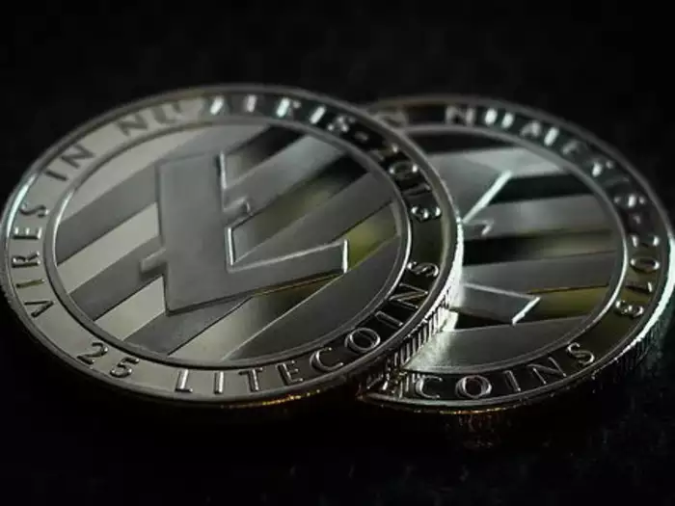
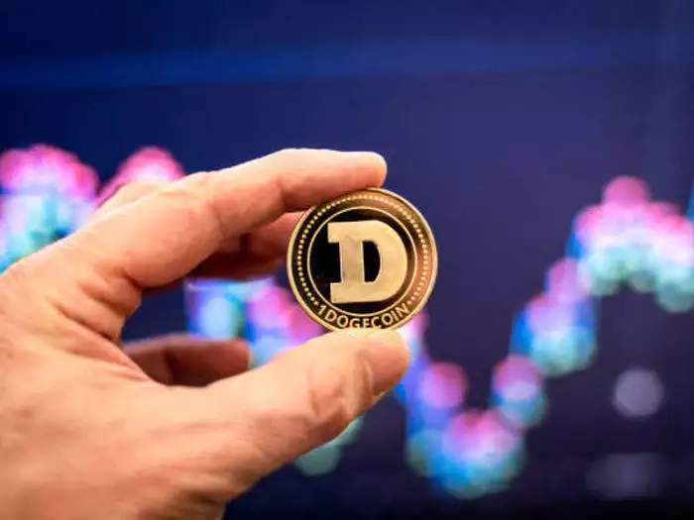

Types of Cryptocurrency
Bitcoin is considered the first cryptocurrency created, and other individual cryptocurrencies are known as "altcoins" (a combo word derived from "alternative coin"). It's difficult to say which cryptos are the best ones, but Bitcoin and some of the largest altcoins out there are top-tier options because of their scalability, privacy, and the scope of functionality they support.

Slide 6
Advantages of using cryptocurrency
Using cryptocurrency could offer opportunities for some businesses. The benefits may include:
A cryptocurrency transaction is generally a quick and straightforward process. For example, Bitcoins can be transferred from one digital wallet to another, using only a smartphone or computer.
Every cryptocurrency transaction is recorded in a public list called the blockchain, which is the technology that enables its existence. This makes it possible to trace the history of Bitcoins to stop people from spending coins they do not own, making copies or undoing transactions.
Blockchain aims to cut out intermediaries, such as banks and online marketplaces, which means there are no payment processing fees.
Cyptocurrency payments are becoming more widely used, amongst large organisations, and in sectors including fashion and pharmaceuticals.

Slide 7
Disadvantages of using cryptocurrency
There are some business disadvantages to using cryptocurrency:
It is possible to lose your virtual wallet or delete your currency. There have also been thefts from websites that let you store your cryptocurrency remotely.
The value of cryptocurrencies such as Bitcoins can change significantly, so some people don't feel it is safe to turn 'real' money into Bitcoins.
The cryptocurrency market is not regulated by the Financial Conduct Authority (FCA) so there are no rules in place to protect your business.
If companies or consumers move to a new cryptocurrency from you or stop using digital currencies entirely, it could lose value and become worthless.
Cryptocurrency exchanges are vulnerable to cyber attacks, which could lead to an irreparable loss of your investment.
Cryptocurrency can be vulnerable to scams. Scammers often use platforms like Facebook, Instagram and Twitter to trick people into these investments. If you suspect you’ve been targeted, it's important to report this to Action Fraud as soon as possible
Cryptocurrency can be a risky investment and you should only consider investing if you're financially equipped and willing to lose any money that you put into it.

Slide 8
Conclusion
Cryptocurrency is an impressive technical achievement, but it remains a monetary experiment.
this summary suggests that cryptocurrency transactions are better compared to bank transaction but it is not aged or experienced as much as banks. And also the crypto markets are not stable compared to banking markets.
As I have tried to show in this presentation, they provide an interesting new perspective from which to view economic questions surrounding currency governance, the characteristics of money, the political economy of financial intermediaries, and the nature of currency competition.

Slide 9
Thank You!

